Slide 1
DOB를 이용한 외발자전거 제어
기계항공공학부 우주항공공학전공
2019-11545 이종안

Slide 2
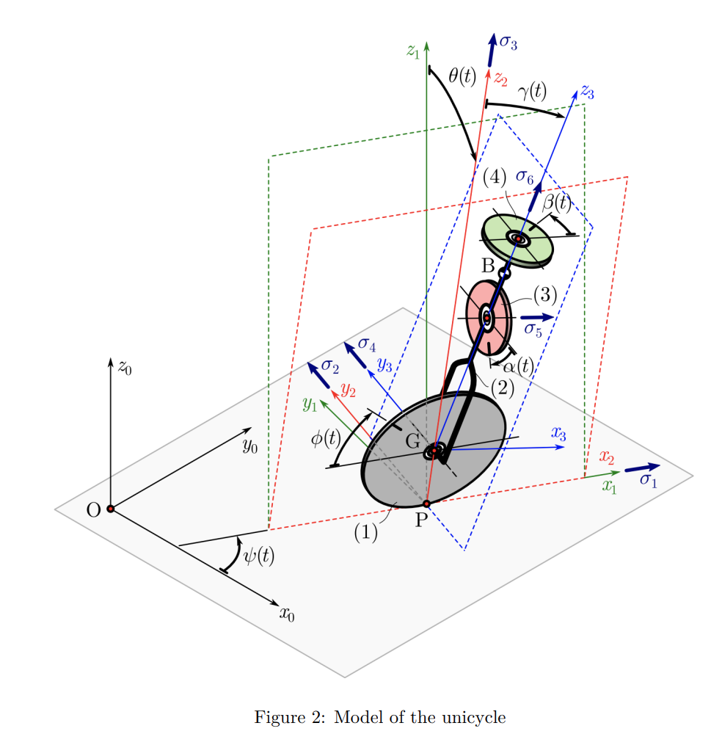
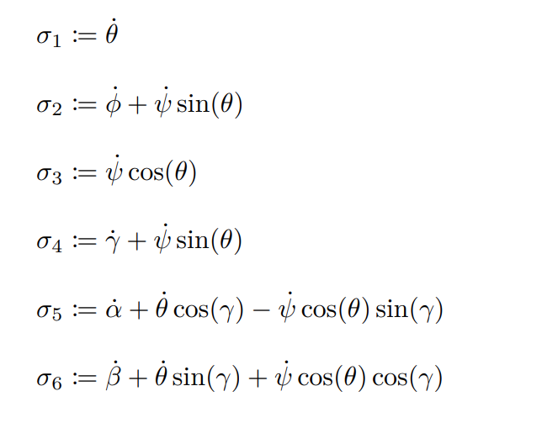
Model
Xincheng Cao et al. “Autonomous unicycle: modeling, dynamics, and control”. In: Multibody System Dynamics (2023), pp. 1–34.
ψ, θ, γ: z-x-y Euler angles
x_G, y_G: 바퀴의 위치
ϕ, α, β: 각 바퀴가 돌아간 각도
σ : Pseudovelocities

Slide 3
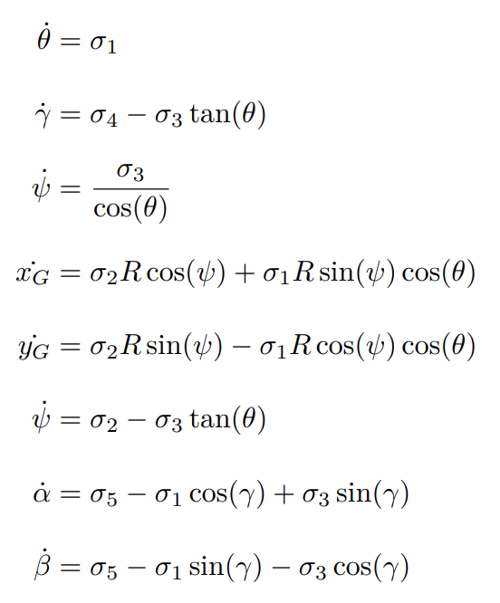
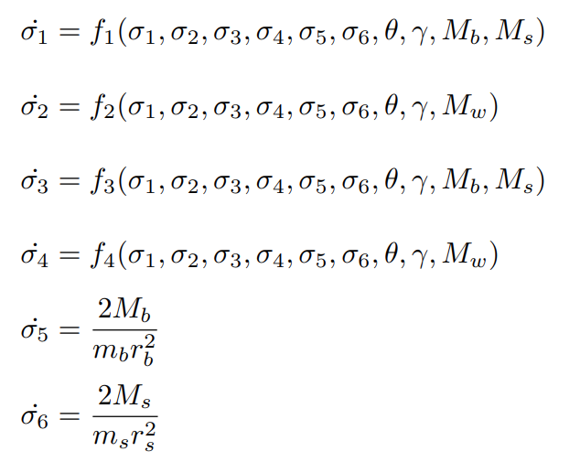
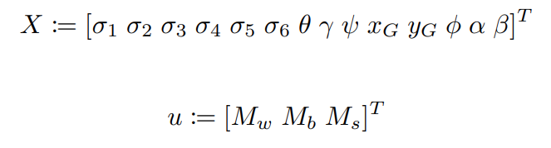
Non-linear Model
The state and input
Wheel Torque

Slide 4
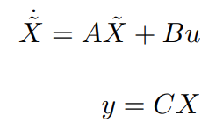
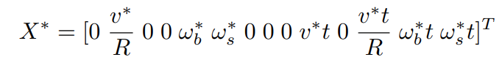
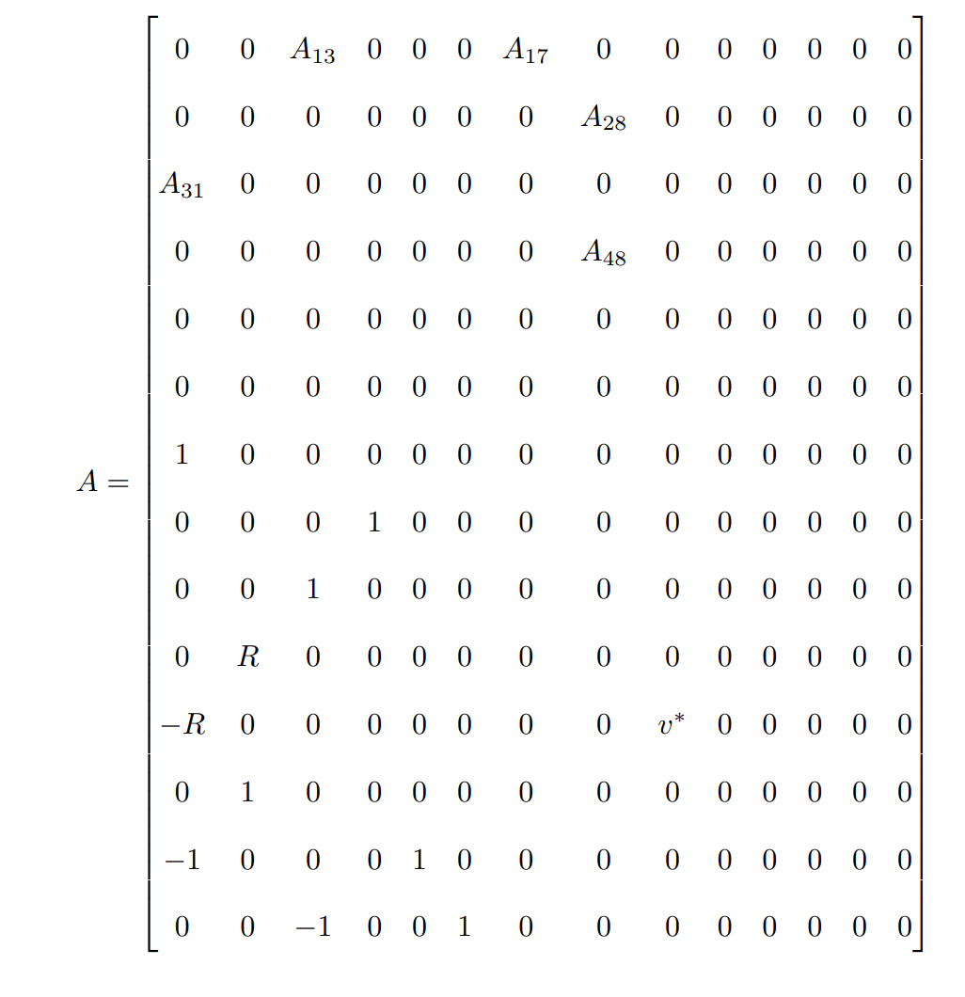
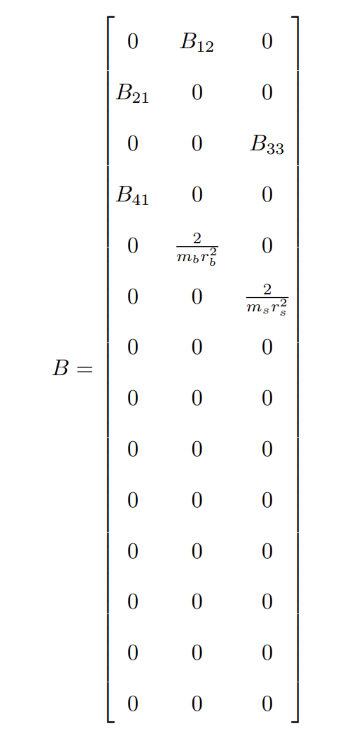
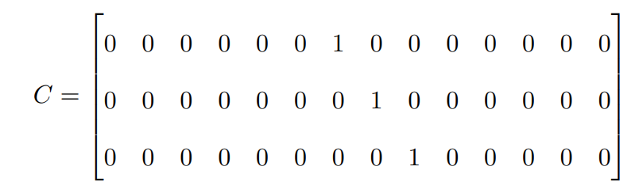
Linearized Model
Form
를 평형점으로 하여 선형화(단 w_b*, w_s*=0)

Slide 5
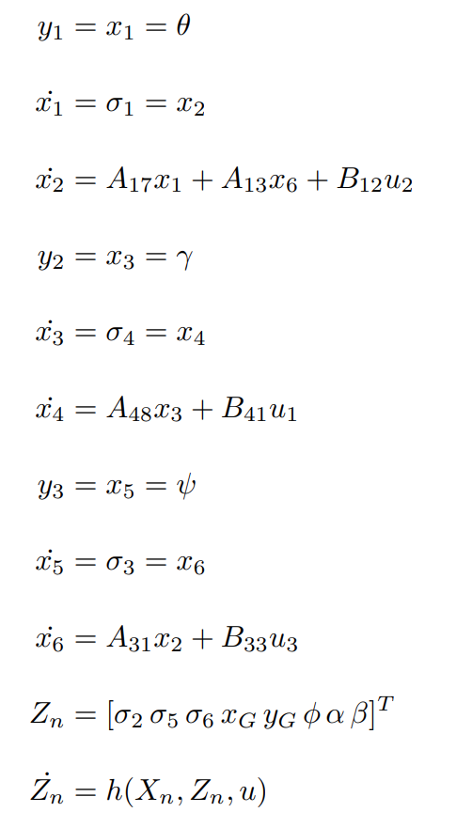
Normal Form
All three have a relative degree of 2
Each input has a matching output y
Zero dynamics do not affect the output

Slide 6
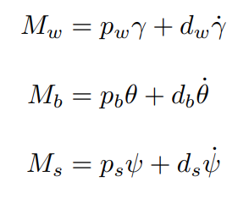
Nominal Plant Controller
Problem: System Not Controllable(rank(Co)=11)
Still stabilizable, so Okay!
Nominal Plant Controller: PD controller of the Euler Angles!
Stability with eigenvalues of x at LHP and z at 0

Slide 7
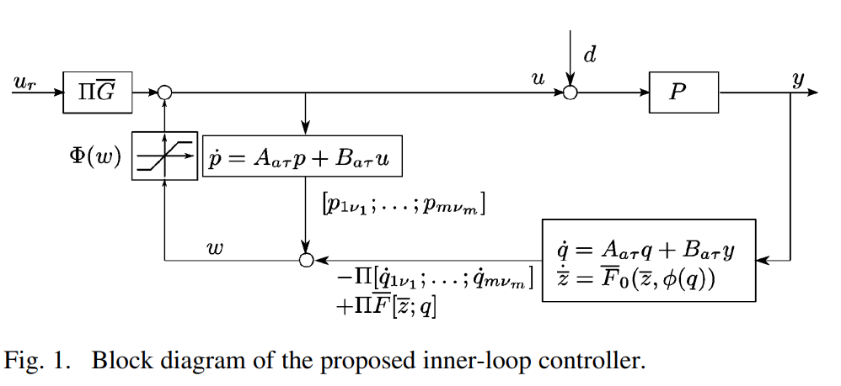
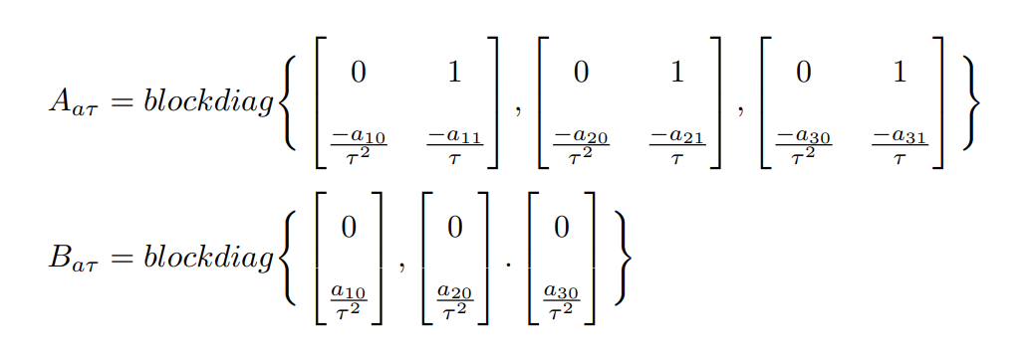
MIMO DOB
Juhoon Back et al. “An Inner-Loop Controller Guaranteeing Robust Transient Performance for Uncertain MIMO Nonlinear Systems”. In: IEEE Transactions on Automatic Control (2009)
MIMO DOB inherently uses separate Q filters for each y
→ Use independent Q filters to estimate x!

Slide 8
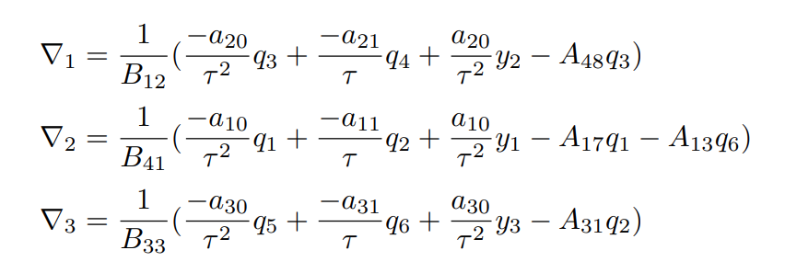
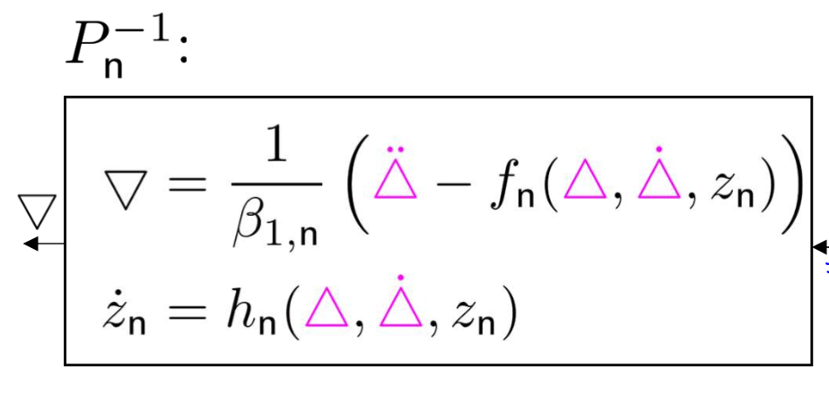
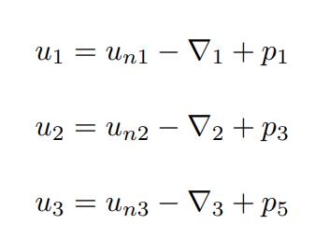
MIMO DOB
Inverse Plant used to estimate u from x
→ Since each u is independent, use the SISO approach

Slide 9
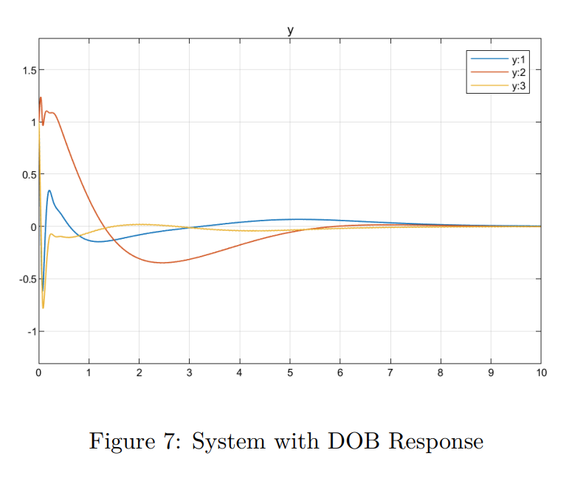
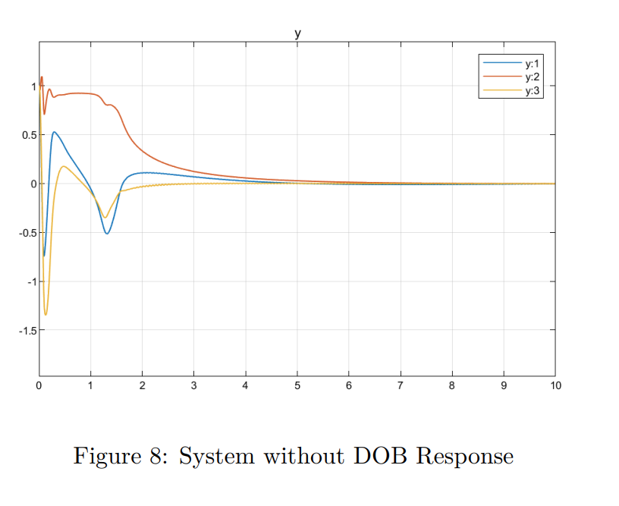
Simulation
Initial position of (1,1,1) rad or 57.3°
DOB decreased overshoot (important to not go over 0.5π=1.57)

Slide 10
Conclusions
Initial PD controller was too good → affect of DOB not apparent
Use a controller without a derivative term next time
Theoretical stability not yet proven

